Slide 1
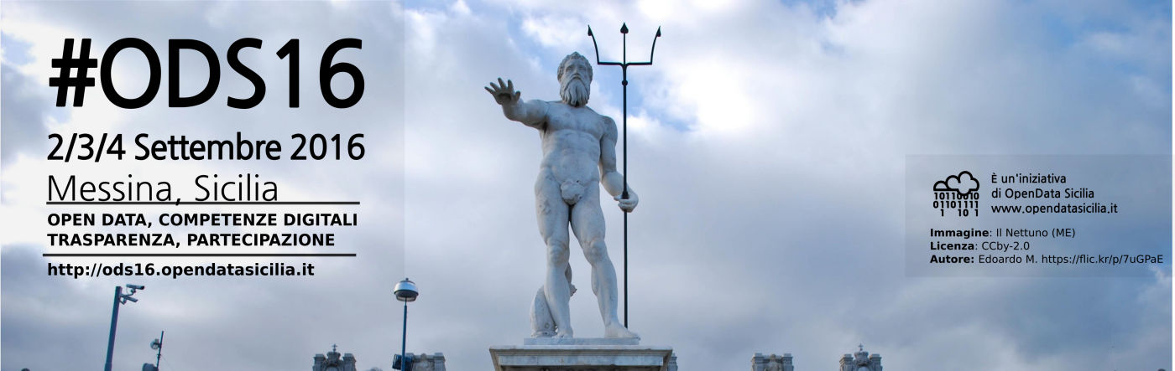

#SmartME project
Dr. Giovanni Merlino
Dept. of Engineering
University of Messina
Italy
Dr. Antonino Longo Minnolo
CIAM
University of Messina
Italy
2 September 2016
Messina, Sicilia

Slide 2




#SmartME project
MDSLab research team
Dr. Dario Bruneo
Prof. Salvatore Distefano
Dr. Francesco Longo
Dr. Giovanni Merlino
Prof. Antonio Puliafito
G. Merlino / A. Longo Minnolo

Slide 3
#SmartME project
CIAM development team
Dr. Antonino Longo Minnolo
Dr. Angelo Cucinotta
Fabio Sfuncia
Nicola Spada
Alberto Pagano
Marco Todaro
Piero Mangano
Francesco Lo Re
G. Merlino / A. Longo Minnolo

Slide 4
#SmartME project
The #SmartME initiative
collaboration of MDSLab and CIAM teams with key actors
Arduino Labs, municipality, university branches
successful crowdfunding initiative
a platform for experimental testbeds
G. Merlino / A. Longo Minnolo
Notes:
The #SmartME project was born from a wish of a team of researchers in the Mobile and Distributed Systems Lab (MDSLab) at the University of Messina who, in collaboration with the Industrial Liaison Office and the Center for Information Services of the University (CIAM), are eager to encourage, in an innovative fashion, a conversation with the municipality of Messina, based upon the paradigm of the Internet of Things (IoT), in order to spur the creation of a novel, virtual, ecosystem.
The project is also involving the university spin-off Arduino Labs, active in the production of innovative solutions for advanced sensor-based systems, and it is sponsored by the Municipality of Messina.
At the foundation of #SmartME lies the belief that research can and should yield benefits for the community, and the other way around too, in a kind of symbiotic relationship based on the “crowdsourcing” pillar.
We are therefore talking about a novel way for academia to play a role with regard to technology transfer, a more “open” grassroots one indeed, aimed as it is even at laymen; a smarter one, because it enables anyone - citizens, researchers, enterprises - to experiment and test new services for the city.
Indeed, the MDSLab team has asked for support on a crowdfunding platform in order for this project to take off for real.
This way, through this crowdsourced fundraising we were able to kickstart the #SmartME project, meanwhile also establishing a community of potential users and/or passionate supporters at the onset.

Slide 5
#SmartME project
Project timeline / roadmap
I Nov. 2014: brainstorming, first idea of #SmartME
II Dec. 2014 - Jan. 2015: aims and goals, first draft architecture, identification of hardware and software technologies
III Feb. - April 2015: crowdfunding initiative
IV April 2015 - Dec. 2015: equipment and device design and assembly
V Sept. 2015 - June 2016: software platform development
VI March 2016 - Dec. 2016: initial infrastructure deployment and operation
VII June 2016 - Dec. 2017: service development and deployment
G. Merlino / A. Longo Minnolo

Slide 6
#SmartME project
Crowdfunding campaign: tiers
Categories of contributions:
1st-tier supporter (no active role, name inclusion in the list)
2nd-tier supporter (as 1st + “thank you” postcard)
3rd-tier supporter (2nd + t-shirt)
user (3rd + privileged/preliminary access to 1st year data)
developer (3rd + 1-year access to infrastructure)
adopting-a-sensor (3rd + user-provided location for deployment)
brand sponsorship (3rd + 1-month advertisement on project site)
G. Merlino / A. Longo Minnolo
Notes:
With regard to the #SmartME crowdfunding initiative, we leveraged Eppela, a well known Italian crowdfunding platform.
Different type of contributions have been identified, based on the corresponding rewards, specifically 7 categories:
1st-tier supporter: for any citizen aiming to support the project without any active role
award - name of the contributor included in the public list of official supporters of project
2nd-tier supporte: award - as 1st tier, plus received a thank you postcard.
3rd-tier supporter: award - all of the above, plus a t-shirt with the #SmartME logo
user: privileged/preliminary access to data collected by the system during the 1st year of operation, both in raw form per each sensor, and in aggregated form
developer: typically an expert in the development of network-enabled applications and services, either in terms of academic research or industrial development
award - guaranteed access to the infrastructure for a timeframe proportional to the amount of contribution, to be enjoyed within a 12-months time interval, in order to run and test her services
adopting a sensor: deployment of a certain sensor in a user-provided position and to get access to data there measured and collected (available also to organizations or even informal groups of citizens)
brand sponsorship: meant for enterprises.
award – all of the above, plus a brand of her own advertised for a whole month, continuously, on the website of the project

Slide 7
#SmartME project
Crowdfunding campaign: results
Successfully terminated after 2 months:
collecting in total Euro 34132 Euros
more than twice the target of Euro 15000
involving 84 backers
16 1st-tier supporters
9 2nd-tier supporters
25 3rd-tier ones
14 users
1 developer
3 sensor adopters
10 brand advertisers
Campaign link:
https://www.eppela.com/en/projects/5787-smartme-la-messina-del-futuro
G. Merlino / A. Longo Minnolo
Notes:
Actual support from different types of contributors, from citizens to public administrations, from researchers to companies

Slide 8
#SmartME project
Example of a #SmartME node
G. Merlino / A. Longo Minnolo
Notes:
The Arduino YUN is a Single-Board Computer powered by an Atmel ATmega32u4 micro-controller and the Atheros AR9331 System-on-a-Chip.
The Atheros MIPS processor supports a Linux distribution based on an Arduino-enabled “flavor” of OpenWrt supporting microcontroller-exposed interfaces to General Purpose I/O (GPIO) pins, called Linino OS.
The board has built-in Ethernet and WiFi support, a USB-A port, micro-SD card slot, 20 digital I/O pins (of which 7 can be used as PWM outputs and 12 as analog inputs), a 16 MHz crystal oscillator, a micro USB connection, an ICSP header, and 3 reset buttons.
The YUN board has been equipped with a Tinkerkit Shield hosting a set of low-cost sensors.
Specifically, a Tinkerkit thermistore, Ldr, and Mpl3115 have been installed as temperature, brightness, and pressure sensor, respectively.
A Groove MQ9 is used as gas sensor to obtain information about air quality.
In particular, CO levels are captured as an indication of air pollution.
A Honeywell HIH-4030 has been chosen as humidity sensor while an Arduino KY38 captures the environmental noise level.

Slide 9
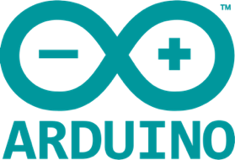

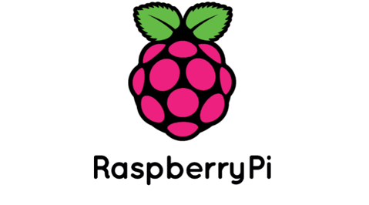
#SmartME project
Architecture of the #SmartME framework
G. Merlino / A. Longo Minnolo
Notes:
The Stack4Things Cloud is exploited as a mediator with respect to the #SmartME nodes.
It exposes a REST API interface which is consumed by the Administration portal.
Through this user-friendly Web interface, the infrastructure administrator can act on the nodes:
querying their status
enforcing system-wide actions
Stack4Things translates such commands to corresponding messages which are delivered to the #SmartME nodes.
#SmartME nodes are programmed to periodically send samples to a set of CKAN datastores.
The Comprehensive Knowledge Archive Network (CKAN) is a web-based open source data management system for the storage and distribution of datasets.
Data delivery is performed trough the CKAN REST API interface.
Data is consumed by the Public portal, which provides a user-friendly showcase through which citizens can browse the #SmartME nodes and have a sneak peek at collected data.
Moreover, the CKAN datastores offer the possibility for both citizens and third party services to:
perform complex queries
retrieve historical series.

Slide 10
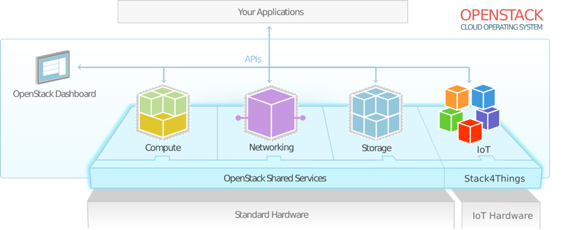
#SmartME project
IoT-Cloud engine: Stack4Things
an OpenStack-based Internet of Things framework developed by the Mobile and Distributed Systems Lab (MDSLab)
an open source project helping administrators to manage IoT device fleets without caring about their physical location, their network configuration, their underlying hardware/software setup
a Cloud-oriented horizontal solution providing IoT object virtualization, customization, and orchestration
enables an out-of-the-box experience on several of the most popular embedded and mobile systems
G. Merlino / A. Longo Minnolo

Slide 11
#SmartME project
Stack4Things: features
object virtualization – interaction with IoT devices as entities in the Cloud through a uniform interface
overlay networks of things – creation and management of Cloud-mediated virtual networks among remote objects
remote control and customization – full customization of devices from low-level firmware/operating system configuration up to business logic
fleet management and delegation – IoT objects can be organized in fleets and controlled hassle-free, coupled with a complex delegation model for a multi-tenant Cloud of objects
fog orchestration – objects orchestrated by aggregating them in IoT ensembles, allowing to build and deploy new Fog-like applications
G. Merlino / A. Longo Minnolo
Notes:
object virtualization - interaction with IoT devices as entities in the Cloud is enabled, together with access to all their hardware and software properties through a uniform interface. Virtual devices can be built by mashing up multiple scattered objects.
overlay networks of things - creation and management of Cloud-mediated or fully peer-to-peer virtual networks among remote objects, enabling the deployment of standard (i.e., not specifically ported) applications on top of the IoT devices, e.g., as they were on the same LAN without caring about NAT/firewall issues
remote control and customization - full customization of devices from low-level firmware/operating system configuration up to business logic, the administrator can operate on nodes through the Cloud interface or remotely access them wherever they are
fleet management and delegation - IoT objects can be organized in fleets and they can be controlled hassle-free, whichever the scale, coupled with a complex delegation model to delegate and revoke permissions to users and groups with tunable granularity, implementing a multi-tenant Cloud of IoT objects
fog orchestration - objects orchestrated by aggregating them in IoT ensembles allowing to build and deploy new applications, implementing a Fog computing platform

Slide 12
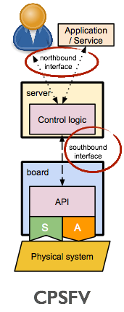
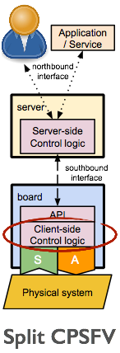
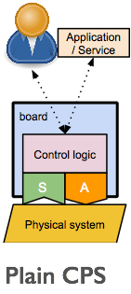
#SmartME project
Stack4Things: Cyber-Physical Systems
G. Merlino / A. Longo Minnolo
Notes:
CPS function virtualization:
3 options to sketch a simple instance of a generic CPS

Slide 13
#SmartME project
Stack4Things: Software-Defined Cities
G. Merlino / A. Longo Minnolo
Notes:
Rewireable smart cities

Slide 14
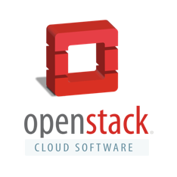


#SmartME project
Stack4Things: underlying technologies
G. Merlino / A. Longo Minnolo
Notes:
OpenStack is a Cloud operating system that controls large pools of compute, storage and networking resources throughout one or more datacenter:
managed through a dashboard that gives administrators control
a centerpiece of infrastructure Cloud solutions, a fully Open Source ecosystem of tools and frameworks..
.. upon which countless international projects and enterprises globally are founding their Cloud strategies
WAMP is an open standard WebSocket subprotocol, two application messaging patterns in one unified protocol:
publish/subscribe
RPC
Node.js is a JavaScript runtime built on V8 JavaScript engine:
uses an event-driven, non-blocking I/O model that makes it lightweight and efficient
its package ecosystem, npm, is the largest for open source libraries in the world.
currently ubiquitous in almost every technology niche, and especially so in IoT
Node-RED (visual tool for wiring IoT APIs)
Cylon.js (framework for cross-platform robotics and physical computing)

Slide 15
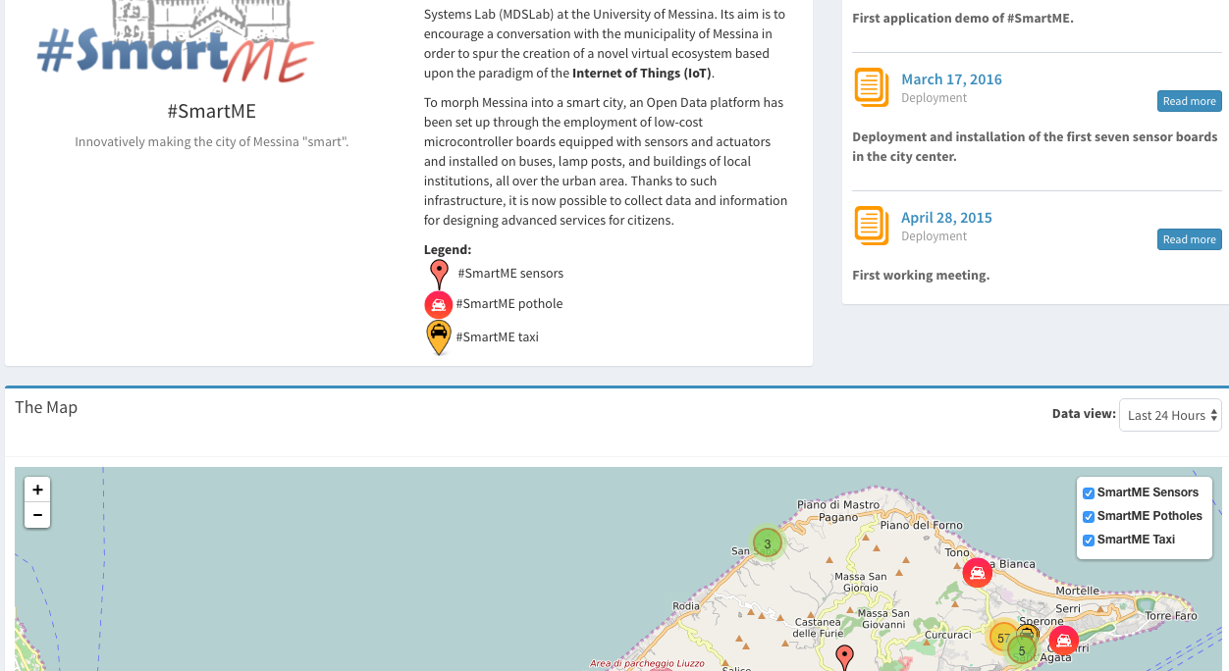
#SmartME project
Screenshot of the #SmartME portal
G. Merlino / A. Longo Minnolo
Notes:
Apart from an intro section, a news log and project credits, there is a:
scrollable, live map with:
a placeholder for each of the boards deployed over the urban area or,
zooming out, a visual cue about the (aggregate) number of boards under a specific marker

Slide 16
#SmartME project
Map detail
G. Merlino / A. Longo Minnolo
Notes:
Clicking on a single board placeholder:
a contextual window will pop up enumerating available (or “coming soon”) sensors/actuators wired to the board
color coded according to the category of observations being produced by each item in the list

Slide 17
#SmartME project
Realtime data
G. Merlino / A. Longo Minnolo
Notes:
Clicking on one of the items will bring up:
an interactive (i.e., zoomable/scrollable) timestamped graph of the latest observations for the corresponding category
a table (underneath) with a list of such observations together with the coordinates, i.e., altitude, longitude and latitude, of the sample, useful in case of mobile nodes.
In the upper left corner a description of the system of units for the samples under consideration, together with a couple of links, to:
download a comma-separated value-formatted dataset, or
access it online as Open Data series on the platform.

Slide 18
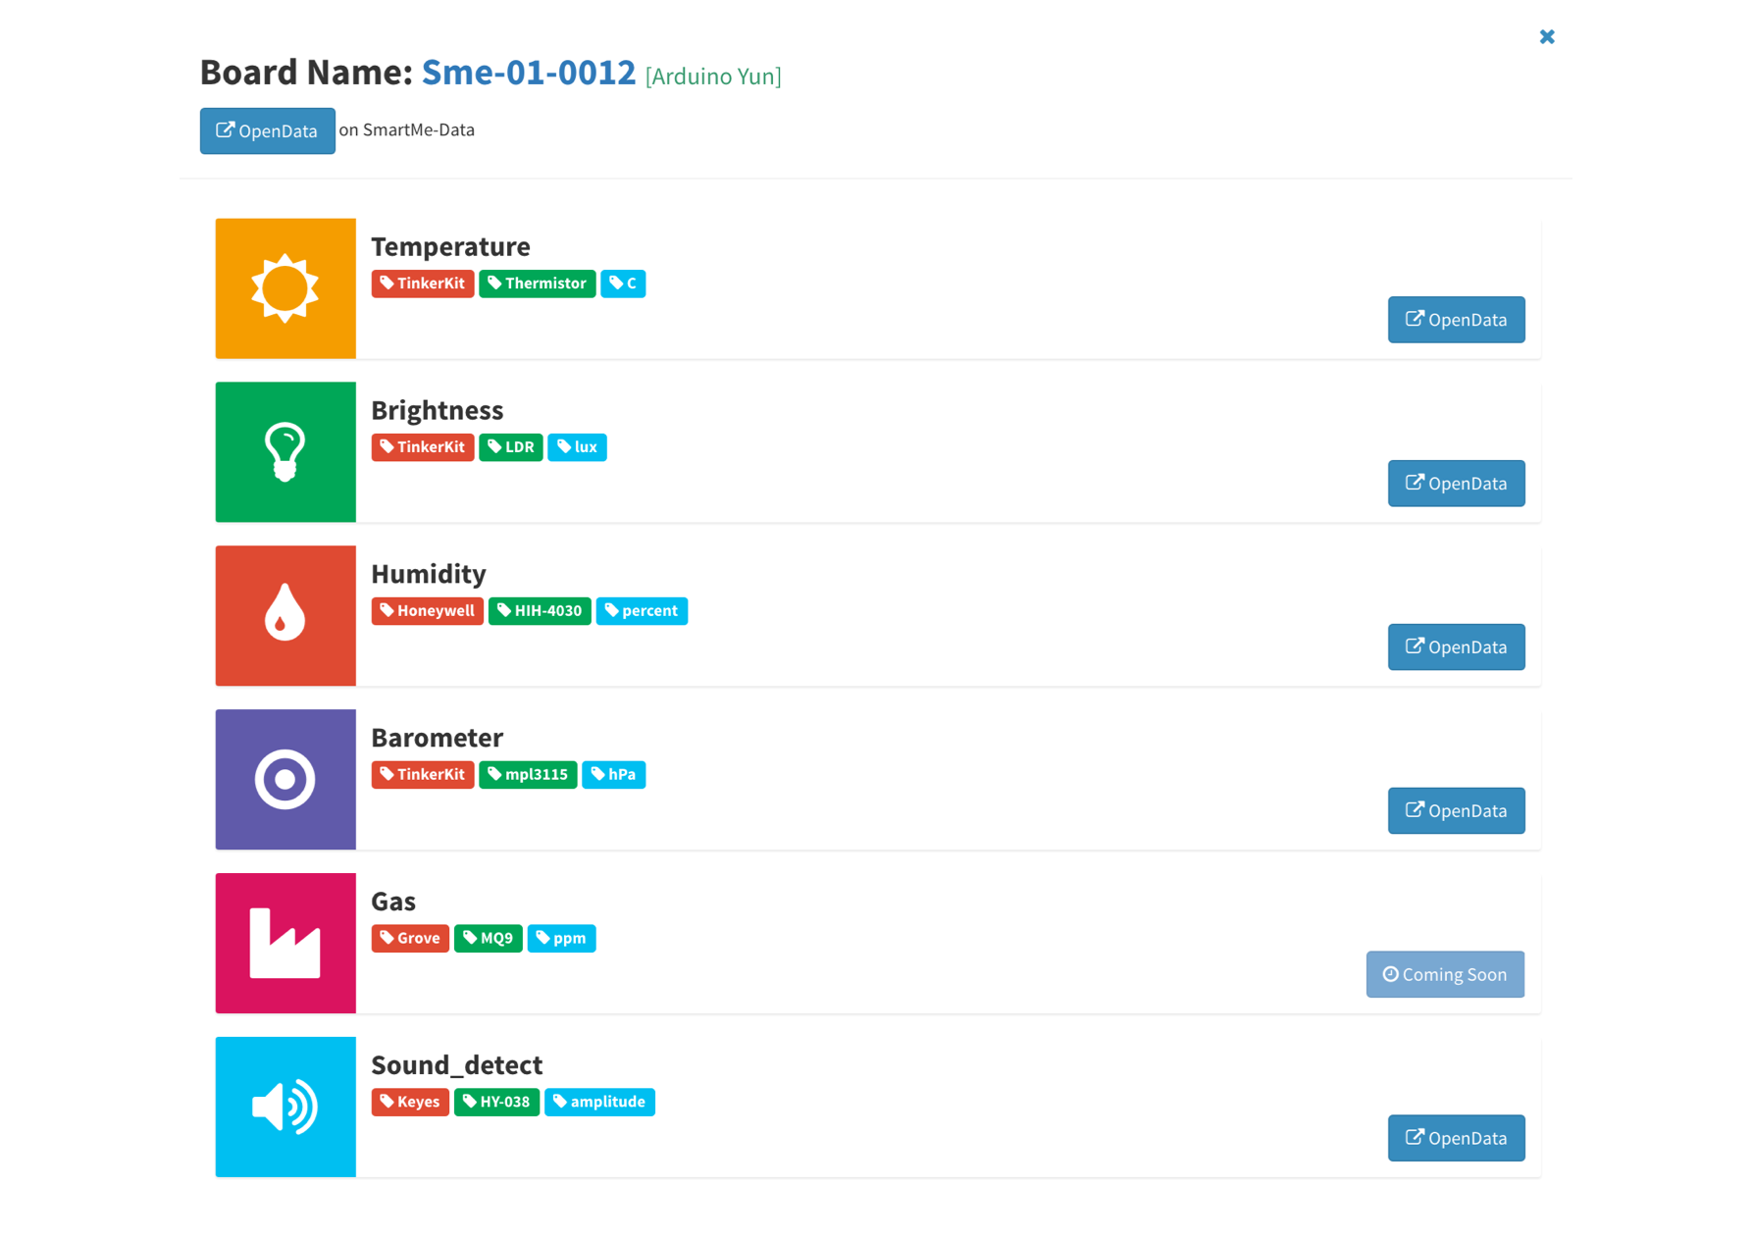
#SmartME project
Board details and datasets
G. Merlino / A. Longo Minnolo
Notes:
In the aforementioned contextual window, clicking on the blue i (information icon), a more detailed outline of the available sensors pops up, where color codes help also in identifying either (red label) the kind of sensor-hosting expansion/daughter-board employed (e.g., Tinkerkit), as well as (green label) the model of the sensor. On the right for each category of measurements we can find a link to the aforementioned historical data

Slide 19
#SmartME project
Management dashboard
G. Merlino / A. Longo Minnolo
Notes:
For the boards’ management functionality, a different website, i.e., a Management portal, is available, at the moment only for operators and other authorized personnel, but meant to be more widely usable in the near future, for running experimentations and providing sandboxing mechanisms for prospective developers of Smart City services.
On the left there is:
a box about boards status and operations
Whilst on the right there are:
buttons for specific categories of commands:
board-specific actions, as well as
plugin / network management
Below the lists there are buttons to trigger:
board registration
metadata updates
deregistration
With regard to management commands, the upper box features buttons for: toggling status LEDs, opening a port on the Cloud for providing SSH sessions tunneled back to the board, and redirecting browsing to the CKAN platform to inspect Open Data collections for the board, respectively.
The middle box displays actionables for:
creating
removing (from Cloud)
injecting (to a set of boards)
starting/stopping plugins
invoking synchronously (“call”) plugin-provided remote procedure calls (RPC)
undeploying (“remove from board”)
plugins, respectively.
The lower box, featuring (overlay) network management operations, features buttons for:
showing
creating and
destroying
networks, as well as
adding/removing boards to a network
showing boards belonging to a certain network
bringing (virtual) network interface up

Slide 20
#SmartME project
Board registration
G. Merlino / A. Longo Minnolo
Notes:
Form for registering a new board to the Cloud, where a code (universally unique identifier) gets generated, populating the Board code field, whereas the other fields are blank and values have to be provided by the user upon registration for:
the label (a user-friendly name)
coordinates (latitude, longitude, altitude)
a flag indicating whether the board is enabled to join Cloud-instantiated overlay networks
a list of flags to be checked, one for each sensor device actually wired to the board

Slide 21
#SmartME project
Plugins
G. Merlino / A. Longo Minnolo
Notes:
Creating a plugin, i.e.:
uploading code to the Cloud
registering it, thus making such code ready to be deployed on boards under the guise of plugins.
The fields include:
name of the plugin to be uploaded
type of plugin (two choices)
operating asynchronously (e.g., sending samples periodically)
synchronously (exposing RPC primitives to, e.g., retrieve a sample)
plugin metadata formatted as JSON
plugin code
Down below is an output field, where the result of the command being executed is displayed

Slide 22
#SmartME project
Networking
G. Merlino / A. Longo Minnolo
Notes:
The operator has to provide a user-friendly name for the network, and the network address (in CIDR notation)

Slide 23
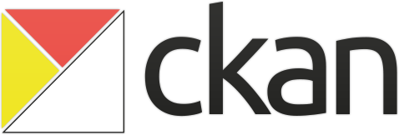
#SmartME project
Open Data: CKAN
a world-class open source data portal platform
provides tools to streamline publishing, sharing, finding and using data
a complete out-of-the-box software solution to make data accessible
available both as downloadable package or as hosted solution by a number of companies
used by governments and organizations worldwide to power both official and community data portals
platform of choice for EU-wide initiatives, such as FI-WARE, where it is available as an official Generic Enabler
G. Merlino / A. Longo Minnolo

Slide 24
#SmartME project
CKAN: features
built with PostgreSQL as database, Pylons framework on the backend and SOLR as search engine
complete catalog system – with easy to use web interface and a powerful API
strong integration with third-party solutions – in particular CMS like Drupal and WordPress
data visualization and analytics
workflow support – lets departments or groups manage their own data publishing
fine-grained access control
integrated data storage and full data API
federated structure – easily set up new instances with common search
G. Merlino / A. Longo Minnolo
Notes:
…

Slide 25
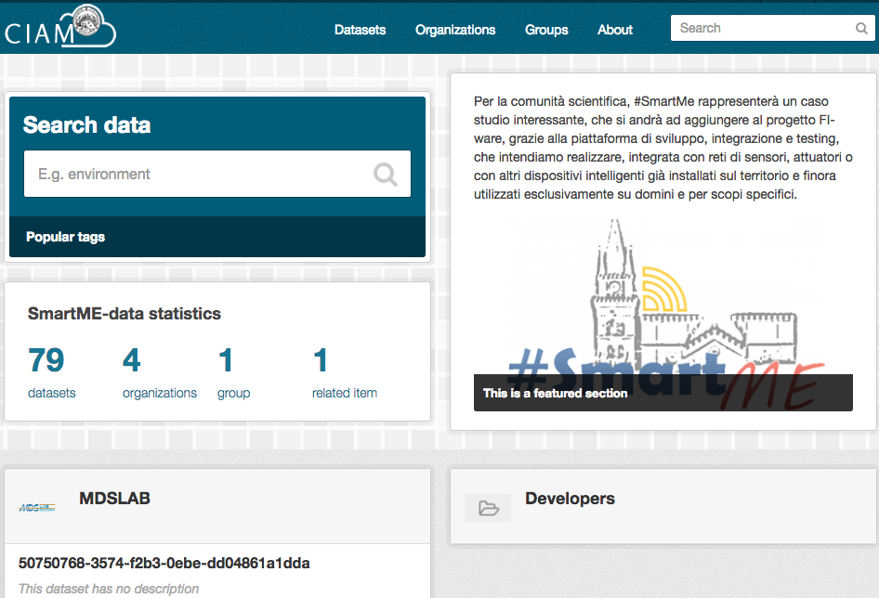
#SmartME project
Screenshot of the #SmartME data portal
G. Merlino / A. Longo Minnolo
Notes:
…

Slide 26
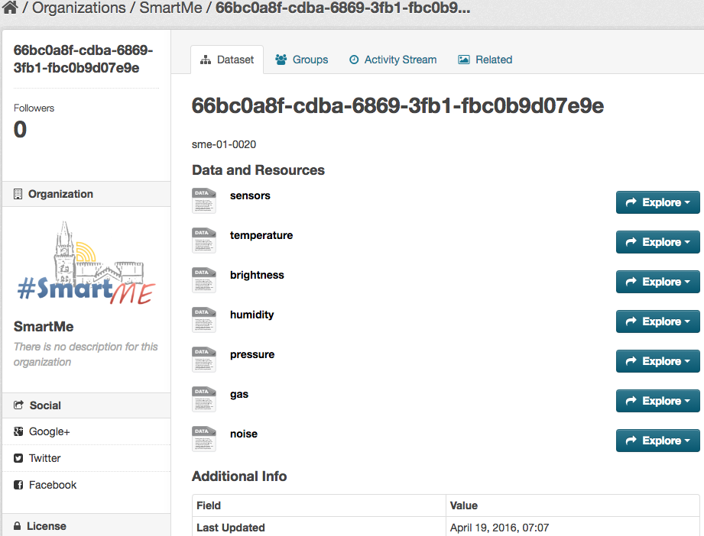
#SmartME project
#SmartME data portal: dataset details
G. Merlino / A. Longo Minnolo
Notes:
…

Slide 27
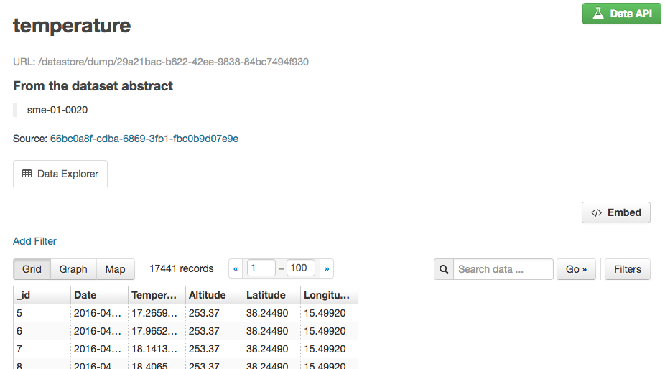
#SmartME project
#SmartME data portal: data explorer
G. Merlino / A. Longo Minnolo
Notes:
…

Slide 28
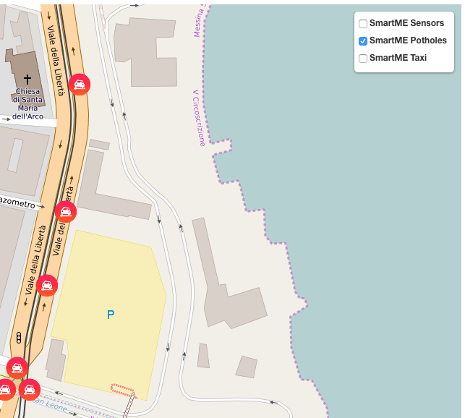
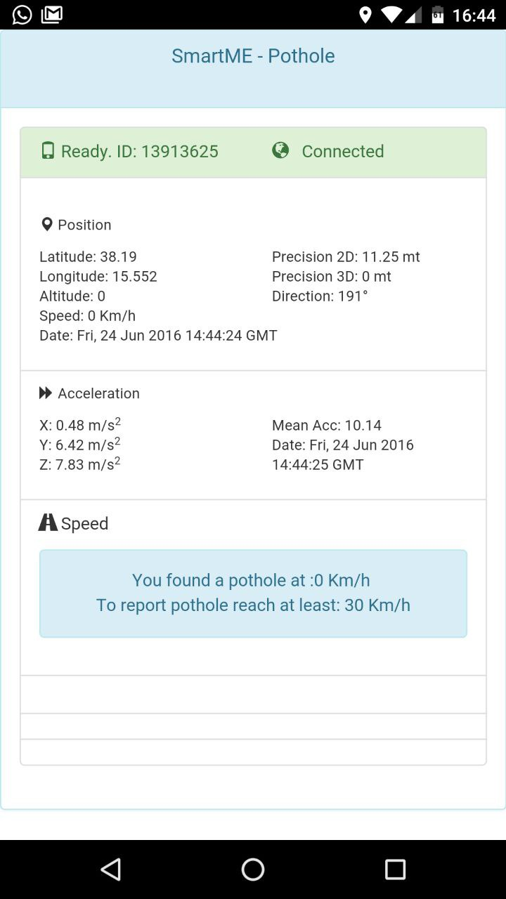
#SmartME project
Example of OpenData-based app:
PotHoles detection
G. Merlino / A. Longo Minnolo
Notes:
…

Slide 29
Open Data@UniMe
Dr. Giovanni Merlino
Dept. of Engineering
University of Messina
Italy
Dr. Antonino Longo Minnolo
CIAM
University of Messina
Italy
2 September 2016
Messina, Sicilia

Slide 30
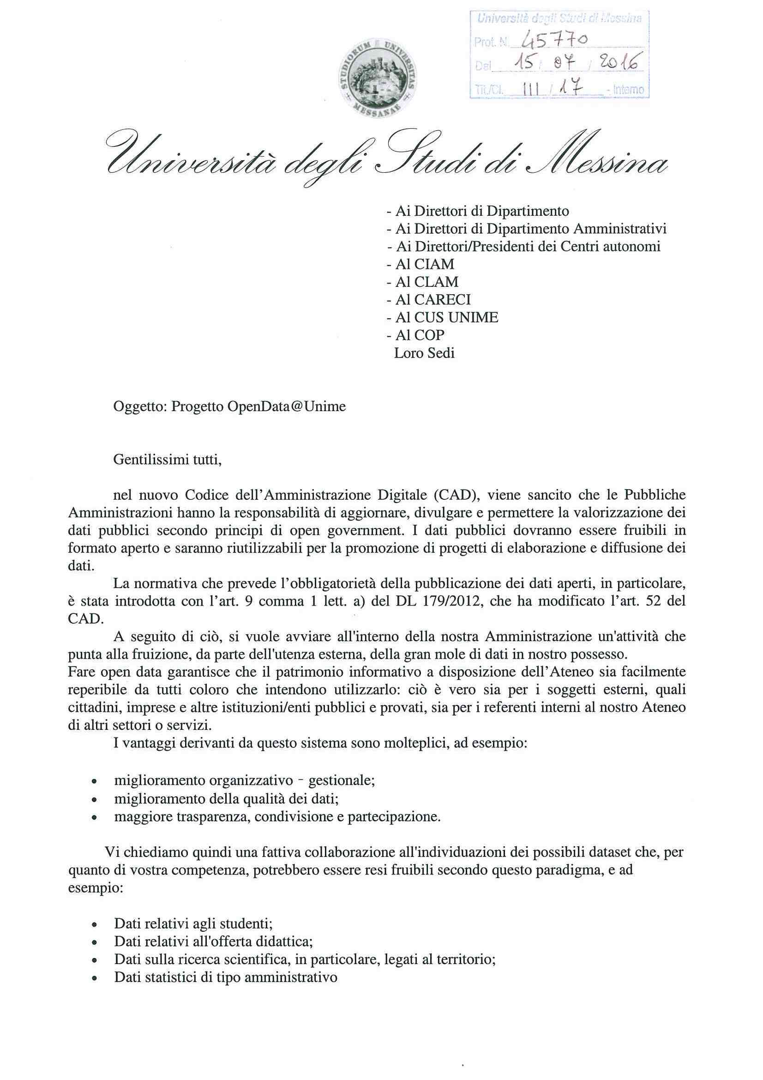
Open Data@UniMe: l’iniziativa è stata avviata
Con una nota Prot. 45770 del 15 Luglio 2016, a firma del Magnifico Rettore e del Presidente del CIAM, è stato avviato il progetto Open Data@Unime: attività che punta alla fruizione, da parte dell'utenza esterna, della gran mole di dati di interesse collettivo, posseduto da UniMe.
Fare open data garantisce che il patrimonio informativo a disposizione dell’Ateneo sia facilmente reperibile da tutti coloro che intendono utilizzarlo: ciò è vero sia per i soggetti esterni, quali cittadini e imprese, che per altri enti così come per i referenti interni all’ente stesso di altri settori o servizi. I vantaggi derivanti da questo sistema sono molteplici:
miglioramento organizzativo – gestionale;
miglioramento della qualità dei dati;
maggiore trasparenza, condivisione e partecipazione.
G. Merlino / A. Longo Minnolo

Slide 31
Open Data@UniMe: quali dati rendere disponibili
Dati relativi agli studenti: numero di iscirtti/immatricolati, provincia di residenza, crediti formativi conseguiti, numero di laureati, ecc..
Dati relativi all'offerta didattica: corsi di laurea, numero di docenti per SSD, ecc…
Dati sulla ricerca scientifica, in particolare, legati al territorio: stato del suolo, composizione dell’aria, ecc..
G. Merlino / A. Longo Minnolo

Slide 32

#SmartME project
Thank you!
http://smartme.unime.it
Giovanni Merlino
Department of Engineering
University of Messina (Italy)
Antonino Longo Minnolo
CIAM
University of Messina (Italy)
gmerlino@unime.it
giovannimerlino
alongominnolo@unime.it
mdslab.unime.it/gmerlino
orcid.org/0000-0002-1469-7860

